Slide 1
HTTP Web Services GET
Module 2: 11

Slide 2
Objectives
Introduction to the Internet
Clients and Servers
Request/Response
URL
Domain Names
Internet Protocol ( IP )
Domain Name System (DNS)
Ports
HyperText Transfer Protocol (HTTP)
APIs and Web Services
REST and RESTful Web services
JSON (JavaScript Object Notation)
RESTful Web Services (API) with GET in Java
Endpoints
RestTemplate
Converting JSON to Java Objects
Endpoint Parameters
Path Parameters
Query String Parameters

Slide 3

Clients and Servers
Server is a generic term referring to either software or hardware that processes request from clients. A server offers shared resources that can be requested for use by a client.
A client is software that sends a request to a server to access a shared resource and processes the response returned from the server.
Client | Server
Chrome Browser | Web Server
Smart TV | Netflix’s computers
Phone | Messaging Server
Email App | Email Server

Slide 4
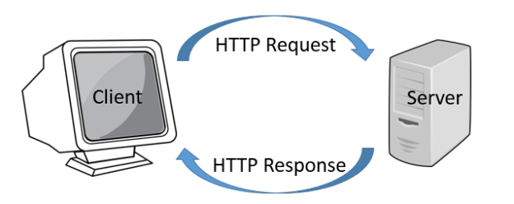
Request and Response
A client sends a request and the server replies with a response.
The HTTP request/response pair is stateless. Meaning that each request/response is independent and without context of previous request/response traded between the same client and server.
In HTTP, all communication between a client and server is via stateless request/response pair.

Slide 5
URL (Universal Resource Locator)
A URL (Universal Resource Locator) tells a client how to make a request to a server for a specific resource.
http://www.techelevator.com:80/events/current?month=march&day=27#00h02m30s
http:// | Protocol
www.techelevator.com | Domain
:80 | Port
/events/current | Path to resource
? | Query
month=march&day=27 | Parameters
#00h02m30s | Anchor/Fragment

Slide 6
Domain Names
Domain names are composed of parts, each separated by a period. Domains start a top level domain and then form a hierarchy of subdomains, each a child of the higher level domain.
Top Level Domains: .com, .net, .org, .gov, .io, …
The hierarchy of a domain name is read right-to-left.
dashboard.techelevator.com
com is the top level domain techelevator is a subdomain of com dashboard is a subdomain of techelevator.

Slide 7
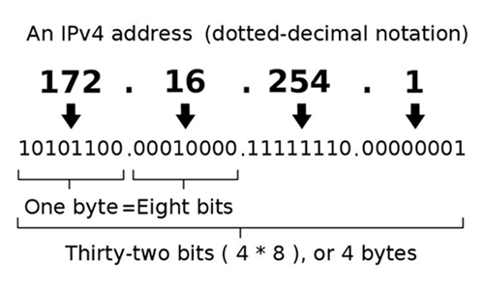
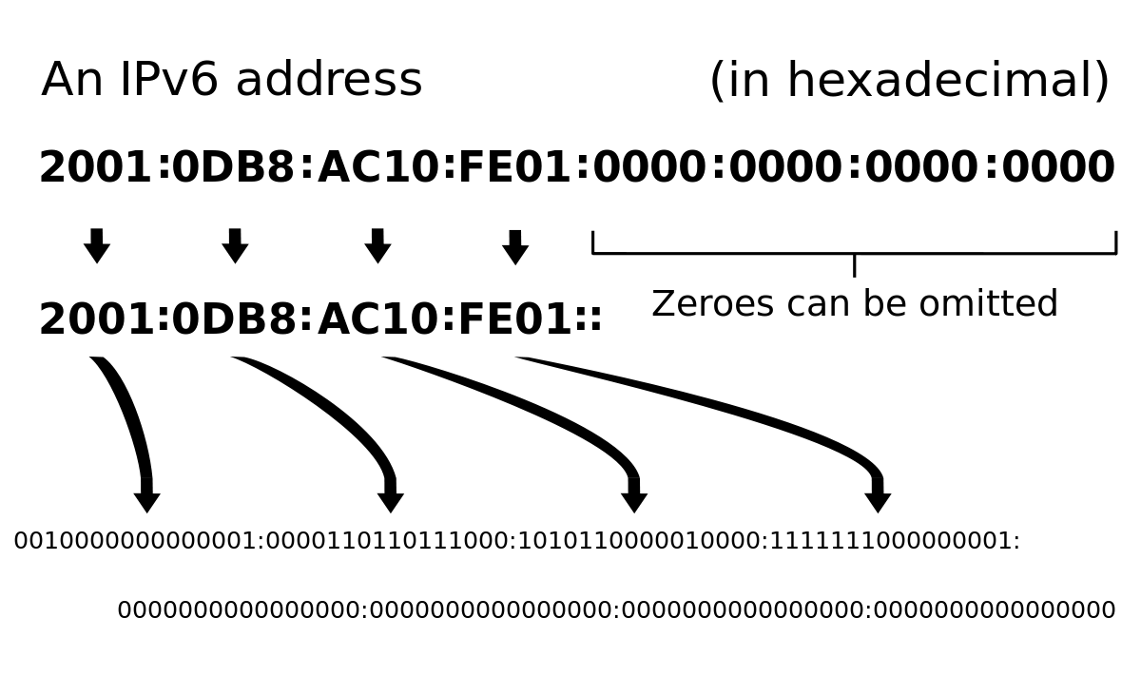
IP (Internet Protocol) Addresses
An IP Address identifies a computer or device on a network (including the internet). All devices/computers on a network must have an IP address to communicate with other devices/computers on the network. It gives the location of the device like the street address of a house.

Slide 8
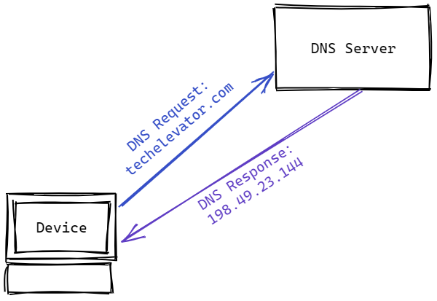
DNS (Domain Name System)
IP Addresses are understood by the computer, but are not easy to use for humans. The Domain Name System (DNS) service allows for easy to remember names for humans to use. It works like a phone book, we give it the human relatable name and it returns the IP address for the computer to use.
Domain Name: techelevator.com IP Address: 198.49.23.144

Slide 9
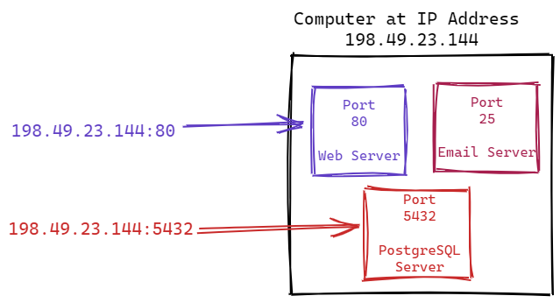
Port
There can be multiple software servers running on a single computer. Port numbers are used to identify which server application should handle the request.
IP Address is like the street address of a building, and the port number would be equivalent to an apartment number in that building.
The Port is added after the IP Address separated by a colon: 198.49.23.144:56
Port numbers range from 0-65535. Ports in the 0-1023 range are referred to as well-known ports and designated for specific uses.
Common well-known ports: Port 80 - HTTP Port 443 - HTTPS Port 25 - SMTP (Email Mail) Port 21 - FTP (File Transfer) Port 22 - SSH (Secure remote terminal)

Slide 10
HTTP (HyperText Transfer Protocol)
A Protocol defines the rules governing how clients and servers will communicate. It is a defined language and process they will use when the client makes a request and the server returns a response.
HTTP and HTTPS (HyperText Transfer Protocol Secure) are the two main protocols used for the World Wide Web and is how browsers and web servers communicate. HTTPS is encrypted with asymmetric encryption called TLS (Transport Layer Security) or often by its original name SSL (Secure Socket Layer)
Parts of an HTTP Request
Method
Requested Resource
Header
Parameters
Parts of an HTTP Response
Status Code
Header
Content Type
Content (Body)

Slide 11
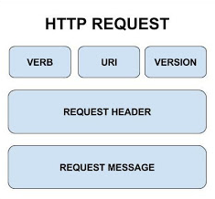
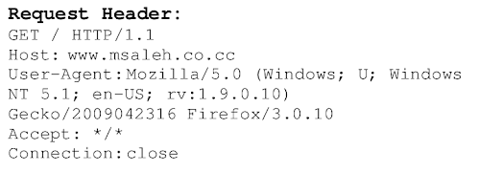
Parts of a HTTP Request
Method (VERB)
GET - Retrieves information
POST - Adds information
PUT - Updates information
DELETE - Deletes information
Requested Resource A resource is something shared by the client. It can be an HTML page, CSS, a file like an image or pdf document, information from a database, access to a stream, or anything else the server can deliver
Header The header contains details about the request, such as the browser, IP address, prefered language, etc.
Parameters Parameters include data to be used to fulfill the request. Similar to arguments sent to a Java method.

Slide 12
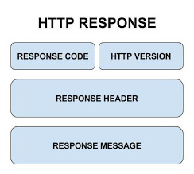
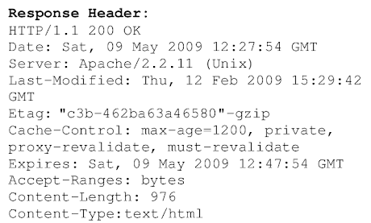
Parts of a HTTP Response
Status Code The HTTP response code indicates the state of the request.
Header Meta Information about the response.
Content Type The type of content being returned: text, json, image, stream, etc.
Content (Body) The output of the response. HTML, image, data, etc.
1xx | Informational
2xx | Success: 200 - OK, 201 - Created
3xx | Redirected: 301 - Moved Permanently
4xx | Client Error: 400 - Bad Request, 401 - Unauthorized, 403 - Forbidden, 404 - Resource Not Found
5xx | Server Error: 500 - Server Exception

Slide 13
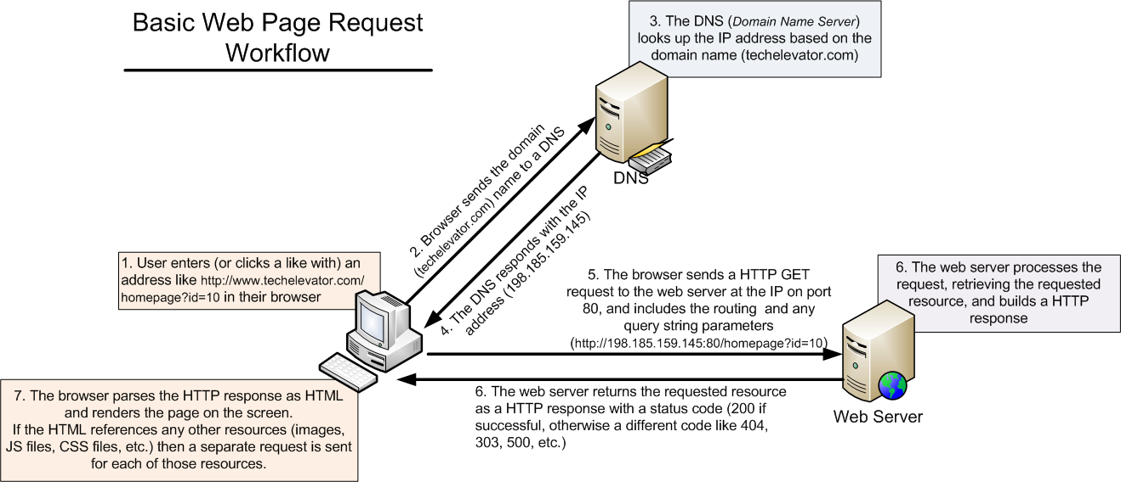

Slide 14
API
Application Programming Interface
An API is a way for software components to talk to each other. The methods and properties in our classes that are exposed as public are the API of the object.
APIs allow communication between any software components, not just the ones in the same application. For example, browsers have an API that allows their functionality to be communicated with from JavaScript programs running inside them. When we use File.createNewFile() in Java it is calling the Operating System’s API to create the file.
APIs commonly allow 2 applications to communicate.

Slide 15
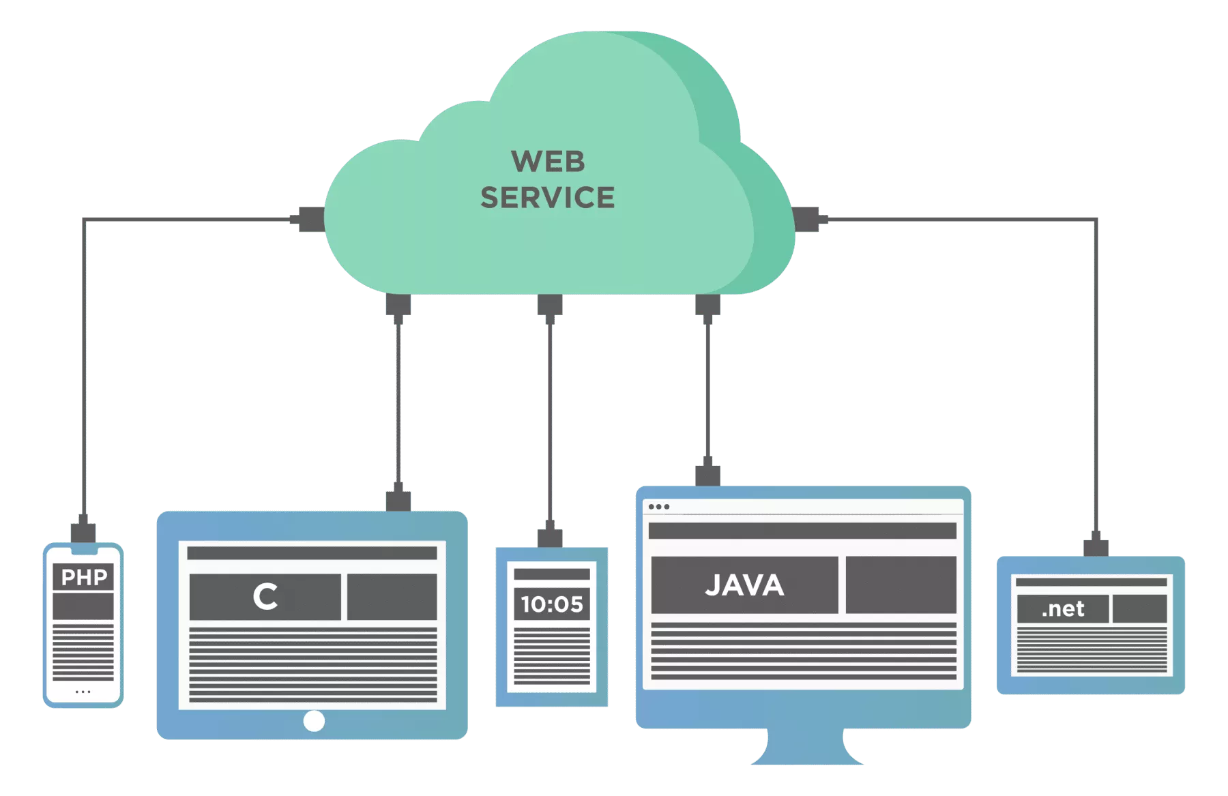
Web Service (Web API)
A Web Service or Web API is an API that allows for applications to communicate with each other across the internet. All Web Services are APIs, however, not all APIs are Web Services.
A set of rules and technologies that enable two or more components on the web to talk to each other.

Slide 16
What is REST?
REST (REpresentational State Transfer) is a software architectural pattern that defines a set of constraints and standards for how 2 applications on a network should communicate. How communication the web is supposed to work.
Rules of REST:
Uniform Interface (URI, URL)
Stateless
Cacheable
Client-Server
Layered System
Do you want to know more?

Slide 17
REST Web Service (Web API)
Web Services that implement the REST standard are said to be RESTful. A REST Web Service (REST API, REST Web API) are Web Services that follow ALL of the REST rules, such as a uniform interface, uniform responses, and properly using HTTP Methods.
Most commonly use HTTP(S) as the application protocol.
Commonly uses JSON as a response.

Slide 18
JSON
{
"reviews": [
{
"hotelID": 1,
"title": "What a great hotel!",
"review": "I thought this was a really great hotel and would stay again!",
"author": "John Smith",
"stars": 4
},
{
"hotelID": 1,
"title": "Peaceful night sleep",
"review": "I had a really good night sleep and would stay again",
"author": "Kerry Gold",
"stars": 3
}
]
}
JSON (JavaScript Object Notation) is a messaging format that is commonly used by RESTful Web Services.
JSON uses key/value pairs to represent objects.
Objects are identified by { }, Arrays by [ ]
Objects have properties and values separated by a colon. The property names are Strings in double quotes. The value can be a number, String (with double quotes), Array, or Object.
Each property/value pair, object, or array is separated by a comma.

Slide 19
Calling a Web Service Using Java
Spring Boot is an open source Java-based framework used to create Web Services. It abstracts much of the repetitive and tedious work needed to create or use a Web Service, much like how SpringJDBC is abstracts JDBC.
Spring Boot provides the RestTemplate, which is a Java based client for calling RESTful Web Services.
Endpoint - an endpoint is URL that points to a Web Service. To access a web service with RestTemplate, we must provide it the API’s endpoint: http://localhost:3000/
String response = restTemplate.getForObject(endpointUrl, String.class);
getForObject() - method that retrieves a JSON response and converts it to an object.
String response - Variable to hold the response.
endpointUrl - the URL of the endpoint to make the request.
String.class - The Data Type of the Object to return. This should match the variable that will hold it.

Slide 20
JSON with Java Objects
The RestTemplate getForObject() method can automatically populate a Java Object from the JSON. The Java Object must have member variables for the JSON properties we want mapped. The data type and name must match!
Getters and Setters must exist for each member variable the RestTemplate will populate, and there must be a no-argument constructor for the class.
Not all properties need to exist in the Java object. The Java Object can include a subset of the properties.
[
{
"id": 1,
"name": "Greektown Detroit",
"stars": 4, “roomsAvailable": 75, "coverImage": "greektown-detroit.webp"
}
]
public class Hotel {
private int id;
private String name;
private int stars;
private int roomsAvailable;
private String coverImage; … getters/setters …
}

Slide 21
Parameters in Endpoints
A Path Parameter (Variable) is one that is passed as part of the resource path in the URL.
http://localhost:3000/hotels/4
http://localhost:3000/hotels/4/reviews
A Query String Parameter is one that is passed as a key/value pair as part of the Query portion (called the Query String) of the URL.
http://localhost:3000/hotels?stars=3

